Slide 1
Security Close to the Applications
ThreatIQ, Geoblocking and Anomaly Detection

Slide 2


Slide 3
Aviatrix ThreatIQ and Threat Guard

Slide 4
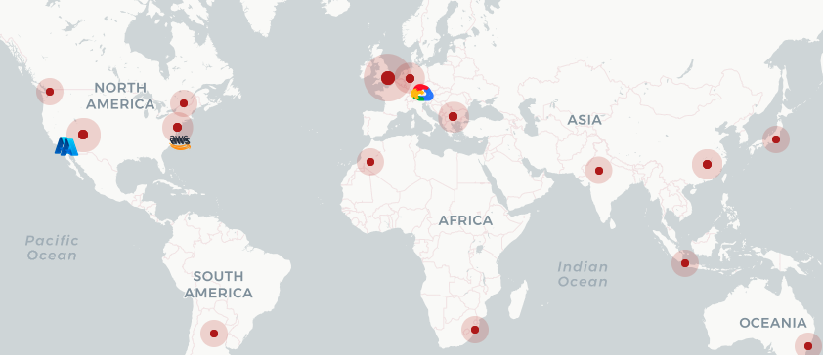
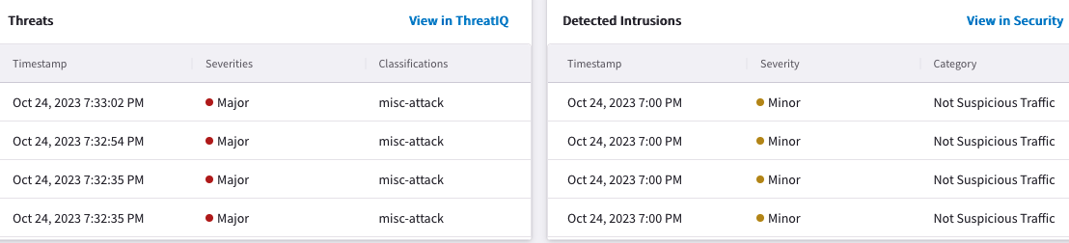
What is it?
Multicloud native network security to dynamically identify, alert, and remediate potential threats to known malicious destinations
Distributed threat visibility and control built into the network data-plane at every hop
Identify potential data exfiltration and compromised host
No data-plane performance impact
Complementary security solution with full multicloud support
Notes:
You'll remember before, I mentioned that the entire aviatrix network is constantly sending NETFLOW’s information to the CoPilot.
As a consequence, the copilot has a very rich source and destination IP addresses DB.
So, a logical next step would be to cross reference this database with a well-known malicious actors database. We want to find out what our private /public workloads are speaking to, and the inverse, which in turn means, if a destination on the internet public zone is authorized to communicate with our workloads.
The two functionalities work throughout the entire network, it’s a distributed threat visibility mechanism.
The purpose here is to avoid discovering unexpected behaviors, where for example a developer that deployed a fleet of servers inside the DEV environment, is using them for personal needs, such as for bitcoin mining or for lending on TOR servers.
There's no impact on the the data plane because this is actually quite passive.
This is not the killer application that is going to keep your entire network secure. We never think that one single feature can secure your entire network. This is about security in layers. This adds another layer of security to the platform.

Slide 5





Why should enterprises care about it?
Internet access is everywhere in the cloud and on by default for some CSPs
Funneling traffic through choke points or 3rd party services is inefficient and ineffective
Protect business from security risks associated to:
Data exfiltration
Botnets
Compromised hosts
Crypto mining
TOR
DDoS, and more
Workloads
Workloads
Notes:
ThreatIQ is all about detecting. it's about finding out what's happening on the network, whereas ThreadGuard is all about blocking that information, taking an action based on a desire.
Every single gateway acts like a sensor.

Slide 6
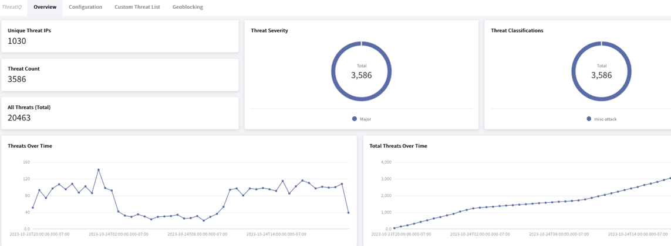
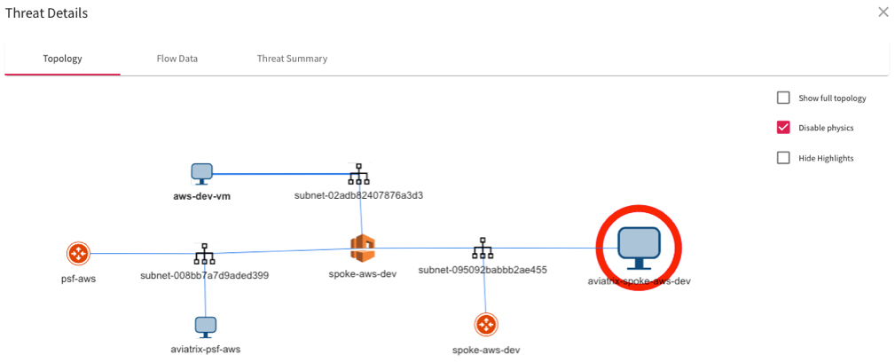
How does it work?
Distributed Inspection & Notification
Aviatrix gateways across Multicloud environment send real-time NetFlow data to CoPilot
CoPilot analyzes the data on all public destinations against well-known Threat DB
CoPilot alerts on any potential threats in the environment
CoPilot provides extreme visibility of the impacted communication flow
Distributed Enforcement
CoPilot informs Aviatrix Controller to push firewall policies to all the Aviatrix gateways in the data path
Firewall policies automatically get updated with the current status of the threat
Blocking threats with firewall policy is optional but recommended
ALERT

Slide 7
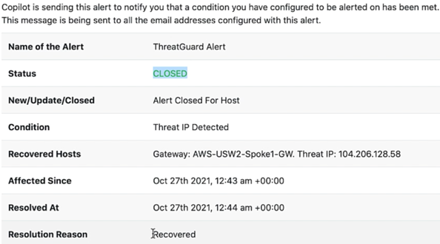
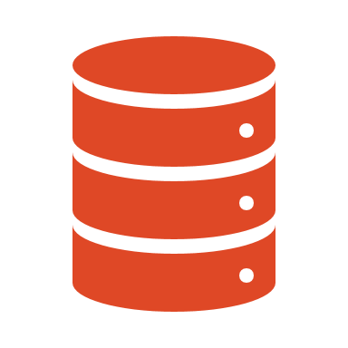



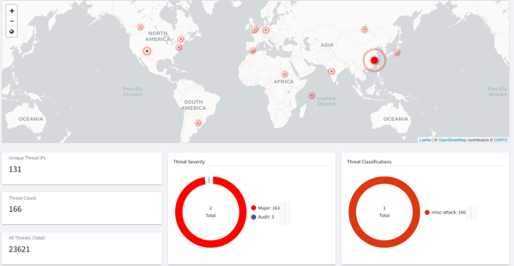
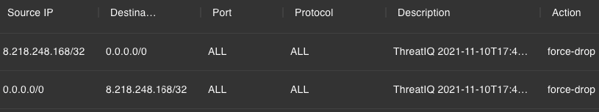



Workflow
4
ALERT
Aviatrix
Controller
Aviatrix
CoPilot
2
Threat DB
ANALYZE
ALERT
5
REMEDIATE
3
VISUALIZE
ALERT
1
DISCOVER
Firewall Rules
Visibility across entire multi-cloud network
Notes:
Let’s have a look at the workflow. Every single gateway sends NetFlow data to the CoPilot. Here we're taking the example of a spoke gateway which is sending Netflow information. This is sent to copilot. Copilot is analyzing this information against a well-known threat database. We use Proofpoint for this third party database. We can visualize that in copilot. So, once we have an alert, we can see where that alert is being noticed on the network, we can get a notification. Based on that alert and then we can actually remediate. So it may be that you do not want to remediate immediately. The alert might be enough. This alerting can be sent to the security team, they can analyze whether this is something they want to actively block or not.
However, what we can also do is in parallel, rather than only sending the alert, we can also take the action to drop it. So, everyone of our gateways is actually also a layer 4 state for firewall. So, we can define a policy, push that policy to the gateway and actually define for instance certain flows and we should force drop those flows. So, this is the entire workflow. It's relatively straightforward.
But it's putting it all together in orchestrating it, which makes it powerful.

Slide 8
Block Threats Based on Geographic Location

Slide 9
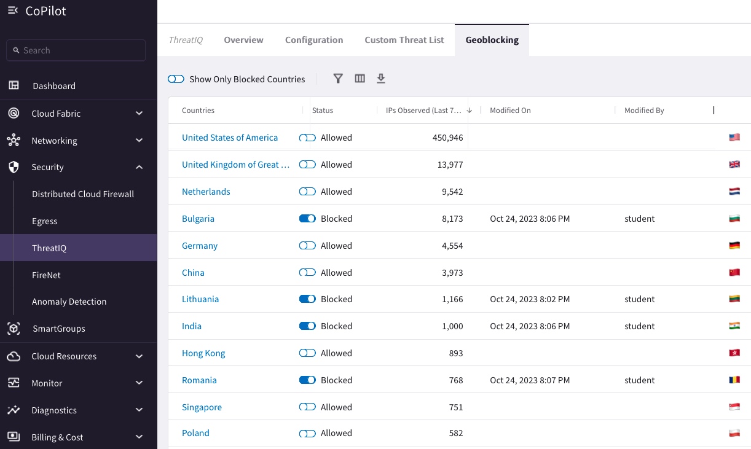
Geoblocking
Notes:
GeoBlocking allows you to select a country to block IP traffic coming into and coming from the country. When GeoBlocking is enabled for a country, a tag-based security policy is implemented on each gateway to deny traffic for IP addresses associated with the country.
All gateways in your VPC/VNets will block. When you unblock a country, the tag is removed from all gateways and the stateful firewall rules instantiated on them for that country are removed.
You access Geoblocking in CoPilot by going to Home > Security > ThreatIQ > GeoBlocking or by typing GeoBlocking in the navigation search.
A list of the countries you can block and unblock displays. The IPs Observed column shows you the number of IP addresses CoPilot observed from each country when scanning Netflow records over the last seven days. If you click on a country name, you can view recent IP traffic going to or coming from that selected country in the time range you specify.
IP traffic coming into and coming from that country will be blocked on each Aviatrix gateway.
https://docs.aviatrix.com/copilot/latest/network-security/geo-blocking.html

Slide 10
Network Behavior Analytics
Aviatrix Anomaly Detection

Slide 11
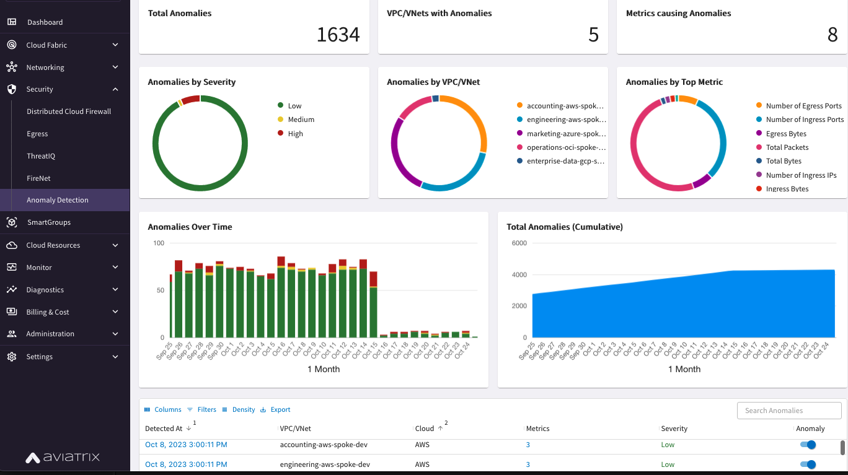
Notes:
https://docs.aviatrix.com/copilot/latest/network-security/network-anomalies.html
Aviatrix CoPilot can perform continuous network behavior analysis on your cloud workloads on a per VPC/VNet basis to learn the routine behaviors of the VPC/VNets based on a group of metrics. The analysis enables CoPilot to detect any unusual network behaviors (anomalies) that could represent threats on your network, systems being down, high traffic for a planned launch, or some other abnormal behavior. You can choose to be alerted when anomalies are detected so you can carry out any needed network operations activities to secure your workloads.
The analysis enables CoPilot to detect any unusual network behaviors (anomalies) that could represent threats on your network, systems being down, high traffic for a planned launch, or some other abnormal behavior.
When enabling network behavior analytics, CoPilot establishes a VPC/VNet network-behavior fingerprint that is custom to your organization’s multicloud activity. The fingerprint is a collection of data and traffic patterns for traffic going into and coming out of all end instances within a VPC/VNet and is the result of CoPilot’s profiling of the VPC/VNet over a configurable period of time or learning period. The fingerprint is a learned data set and behavioral baseline against which CoPilot can detect abnormal network operating patterns or anomalies.
At the conclusion of the learning period, CoPilot can begin detecting anomalies from the fingerprint of the applicable cloud workloads and begin sending alerts for the same if alerts are enabled. The alerts signify active network behaviors that could represent expected network activity or could represent an active threat such as data exfiltration or lateral movement. When CoPilot sends an alert for anomalies detected, the alert contains the details of the metric(s) whose percentage of deviation was outside of the normal fingerprint.
Anomalies are assigned a low, medium, or high severity. The severity level depends on how much the overall traffic that caused the anomaly deviated from established thresholds derived from fingerprinted operating patterns:
Low — Less than 50% deviated from outlier threshold.
Medium — Less than 50 - 75% deviated from outlier threshold.
High — More than 75% deviated from outlier threshold.
CoPilot considers various metric data points when establishing the network-behavior fingerprint. When analyzing active network behavior, CoPilot tracks how many standard deviation points the active network behavior of each metric is from the behavior of the fingerprint. A single anomaly can be associated with one or multiple metrics that have deviated from the behavior of the fingerprint.
You can set a sensitivity level for detecting anomalies that determines how small or large a deviation in normal traffic patterns must be for CoPilot to consider it an anomaly. A higher sensitivity means any small deviation from the fingerprint behavioral baseline is considered an anomaly. High sensitivity could cause alert fatigue when alerts are enabled. A lower sensitivity means an anomaly is detected only when there is a large deviation from the fingerprint behavioral baseline. In this case, anomalies that are greater outliers are detected.
When detecting anomalies, CoPilot compares active network behavior at one-hour intervals against the fixed fingerprinted data set.

Slide 12
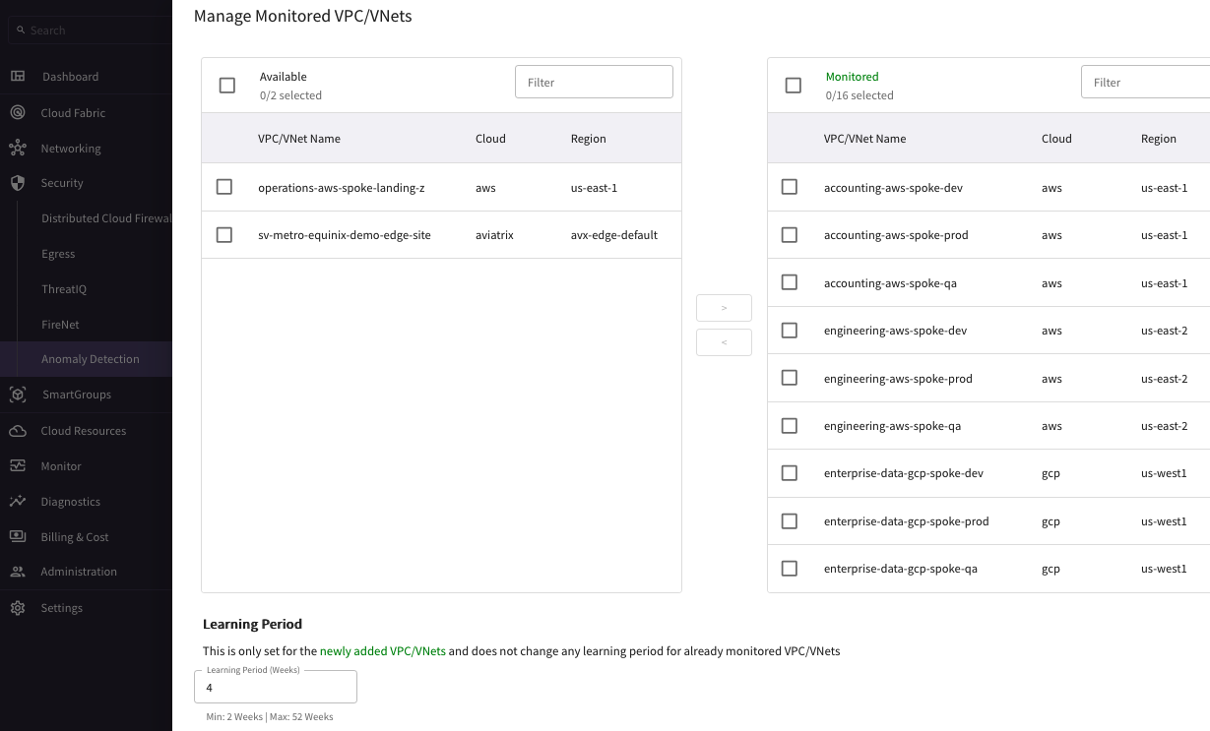

Slide 13
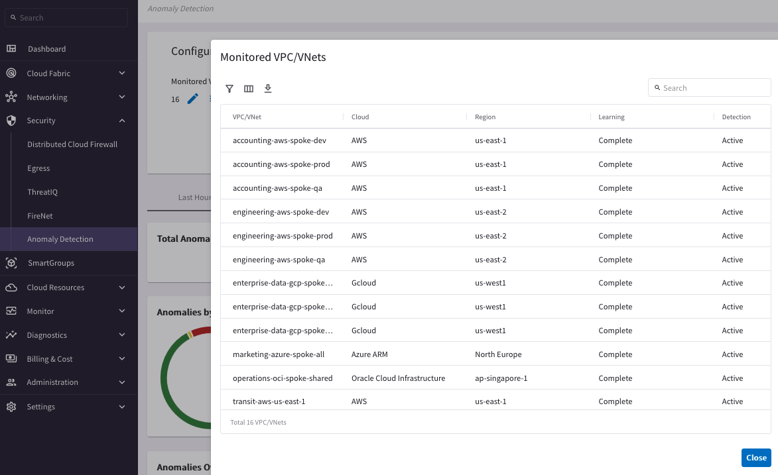

Slide 14


Aviatrix Certified Engineer (ACE)
COMMUNITY
https://aviatrix.com/ACE
https://community.aviatrix.com

